Slide 1
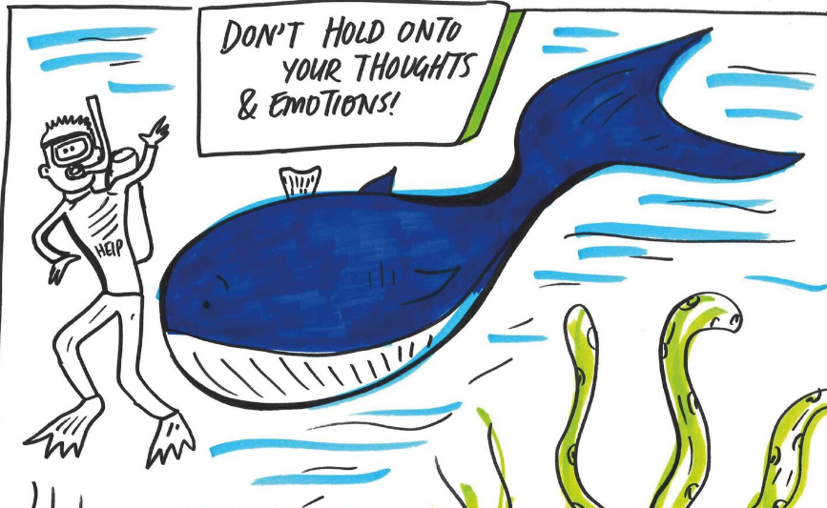
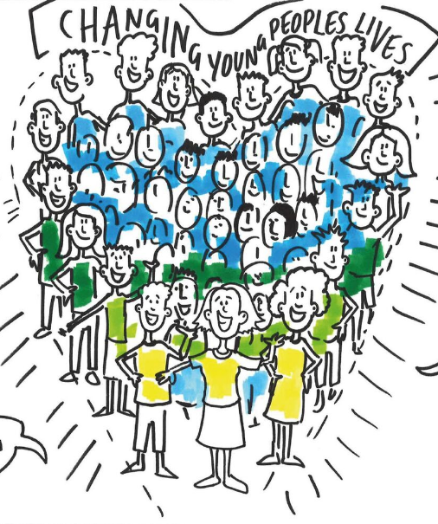
Instead … let’s think about …
Your health & Well-being
Where you spend your time
Who you spend your time with

Slide 2
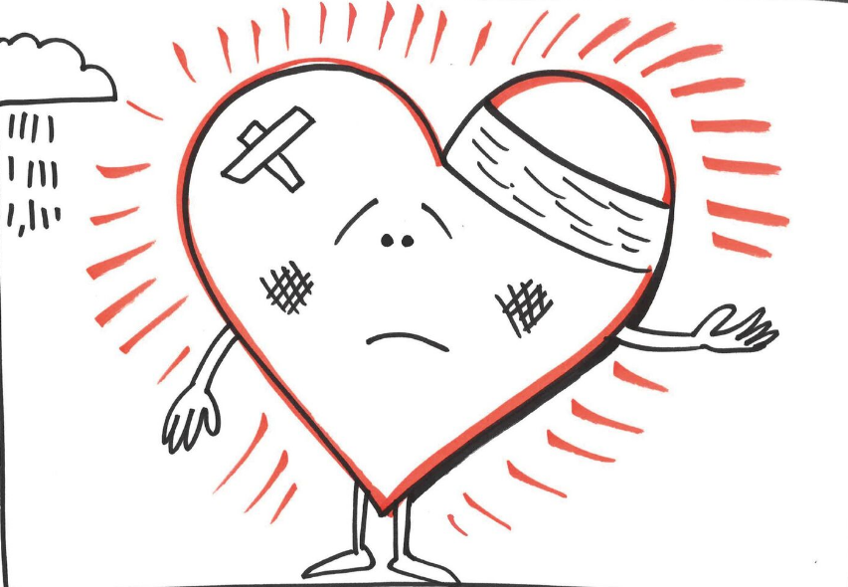
1. How are you feeling today?
2. How is your general health?
3. Are you eating ok all of the time?
4. Do you smoke anything?
5. Do you drink any alcohol?
6. Have you taken any medicine
or other drugs?
7. Do you always feel safe?
8. Do you have any worries?
Let’s think about …
Your health & Well-being

Slide 3
Where do you live?
Who do you live with?
What are the rules like where you live?
Are you happy there?
Is where you are living always safe?
How are you sleeping?
Do you ever stay out overnight?
Where do you go to school/study/work?
How would you describe your attendance?
10. Do you need or get extra help with your learning?
11. Is there anything you’d like to change?
Let’s think about …
Where you spend
your time

Slide 4
What do you do for fun?
Who do you spend most of your time around?
Who do you trust most?
Tell me about the people you chat to online?
Have you got a boyfriend or a girlfriend? (we ask everyone regardless of sex)?
Are you or have you ever had sex with someone?
I have to ask you this: Do you feel like you
are in a situation that you are not comfortable with?
Is anyone hurting or upsetting you at the moment?
Do you or have you ever seen a social worker or counsellor?
Is there something I’ve not asked that you want to talk to me about today?
Let’s think about …
Who you spend your time with

Slide 5
Thinking about our next steps
1. SITUATION: What are the main thoughts we’ve discussed?
2. BACKGROUND: What else have we thought about?
3. ASSESSMENT: What do we think about the situation?
4. RECOMMENDATIONS: What do we think we should do next?

